Slide 1
Routing Algorithm
Prof. Ramesh Ragala

Slide 2
Network Layer
Design issues
Routing
Congestion
Internetworking
Internet Protocols
Multimedia or QoS

Slide 3
Design issues
Goal of layer: get packets from source host to destination host
Routing: should know about topology of subnet
Congestion: should avoid overloading some communication lines and routers
Quality of service: offer the appropriate service
Internetworking: deal with network differences, if source and destination are connected to different networks

Slide 4
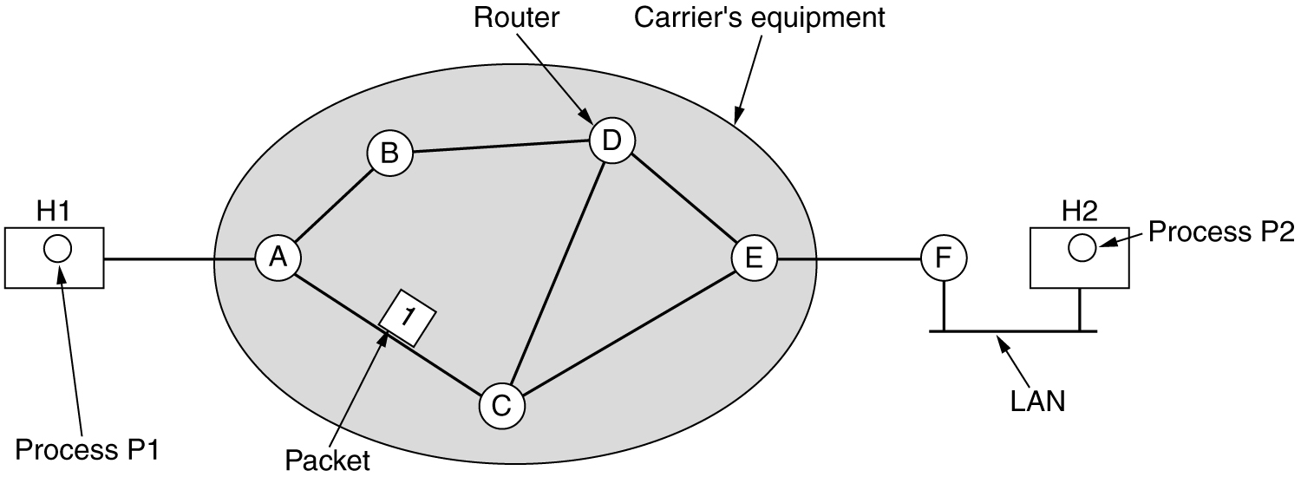
Design issues
Store-and-forward packet switching
Equipment of: carrier <> customer
Algorithm at router
Receive packet
Check packet (e.g. checksum)
Forward packet

Slide 5
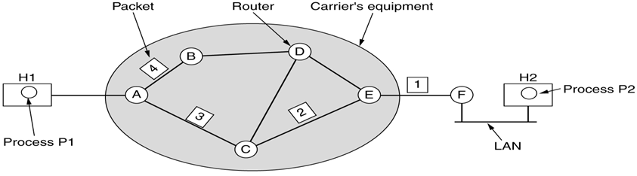


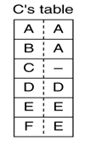

Implementation of Connection Less Service
Routing within a Datagram subnet.

Slide 6
Datagram networks
No Call Setup At Network Layer
Routers: No State About End-to-end Connections
No Network-level Concept Of “Connection”
Packets Forwarded Using Destination Host Address
Packets Between Same Source-destination Pair May Take Different Paths
application
transport
network
data link
physical
application
transport
network
data link
physical
1. Send data
2. Receive data

Slide 7
Virtual Circuits
“Source-to-destination path behaves much like Telephone Circuit”
Performance-wise
Network Actions Along Source-to-dest Path
Call setup, teardown for each call before data can flow
Each packet carries VC identifier (not destination host address)
Every router on Source-destination path maintains “state” for each passing connection
Link, router resources (bandwidth, buffers) may be allocated to VC

Slide 8
VC implementation
A VC consists of:
Path from source to destination
VC numbers, one number for each link along path
Entries in forwarding tables in routers along path
Packet belonging to VC carries a VC number (No Destination Address).
VC number may be changed on each link.
New VC number comes from forwarding table

Slide 9
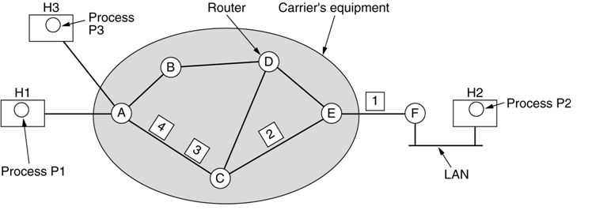
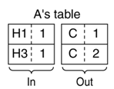

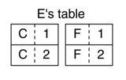
Implementation of Connection Oriented Service
Routing within a Virtual-Circuit subnet.

Slide 10
Virtual circuits: signaling protocols
Used To Setup, Maintain Teardown VC
Used In ATM, Frame-relay, X.25
Not Used In Today’s Internet
application
transport
network
data link
physical
5. Data flow begins
6. Receive data
application
transport
network
data link
physical
4. Call connected
3. Accept call
1. Initiate call
2. incoming call

Slide 11
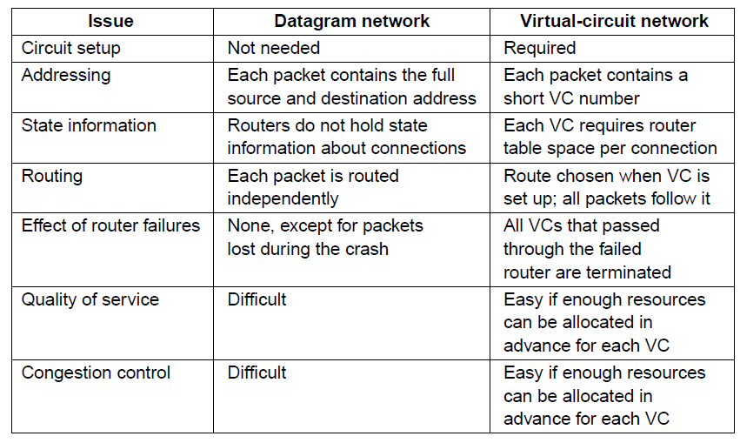
Comparison of Datagram and Virtual-Circuit Network

Slide 12
Routing Algorithms
Properties
Shortest Path Routing
Flooding
Distance Vector Routing
Link State routing
Hierarchical routing
Broadcast routing
Multicast routing

Slide 13
Routing Algorithms
Purpose of Routing
However , all nodes in the network are not directly connected.
Nodes in the network must forward the information to other nodes.
The process of determining where to forward packets and actually doing is called routing.
Session Routing.
Each router has two processes.
1. one process handles incoming packets and forwarding
2. other process update and fill the routing table.

Slide 14
Routing algorithms
Desirable properties
Correctness
Simplicity
Robustness: able to cope with
changes in topology, load
hardware and software failures
Stability
Converge to equilibrium
Fairness
Optimality
}
all algorithms
⎫⎬⎭
hard to achieve
}
conflicting

Slide 15
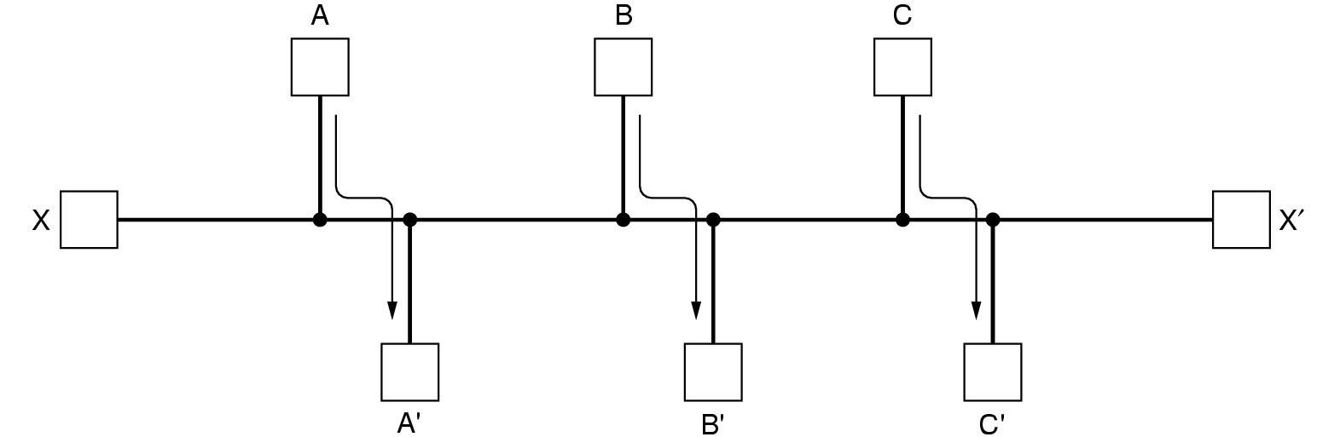
Routing algorithms
Desirable properties (cont.)
Fairness
Optimality
Conflict!

Slide 16
Routing algorithms
Taxonomy
Non adaptive (static Routing)
Routing decisions computed in advance, off-line and downloaded
Adaptive
To changes in
Topology
Load
Get information
Locally
From adjacent routers
From all routers

Slide 17
Routing algorithms
Principle of Optimality
It is a general statement about optimal route with out regard to network topology or traffic.
It states that, if a router – J is on the optimal path from router – I to router – K, then the optimal path from J to K also falls along the same route.
The set of optimal routes from all sources to a given destination form a tree is called sink tree. The root of the sink is a destination node.

Slide 18
Routing algorithms
Optimality principle
Optimal path from I to K over J
I 
● K
d₁
distance
d₂
d₁ + d₂ is minimal
J
●
d₃
Other path from J to K
d₃ > d₂
as
d₁ + d₃ > d₁ + d₂
Set of all optimal routes
from all sources
to a given destination
is a tree: sink tree

Slide 19
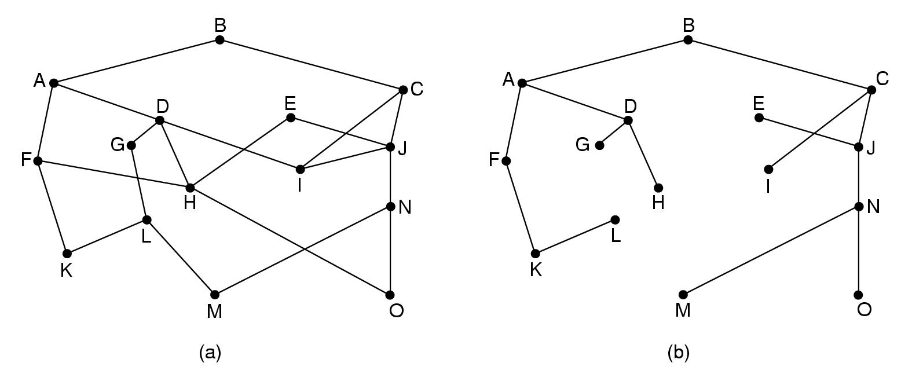
Routing algorithms
Optimality principle: sink tree
Destination

Slide 20
Routing: shortest path
Algorithm of Dijkstra: shortest path in graph → static algo
Graph for a subnet
Node = router
Arc = communication line
Metric
Number of hops
Geographic distance
Mean queuing and transmission delay
Initially, no paths are known, so all nodes are labelled with infinity. These are temporary labels.
As algorithm, proceeds the path found, the label values are changes. → gives the better paths.
Label may be tentative or permanent. Initially all labels are tentative. After applying algorithm, label are permanent.

Slide 21
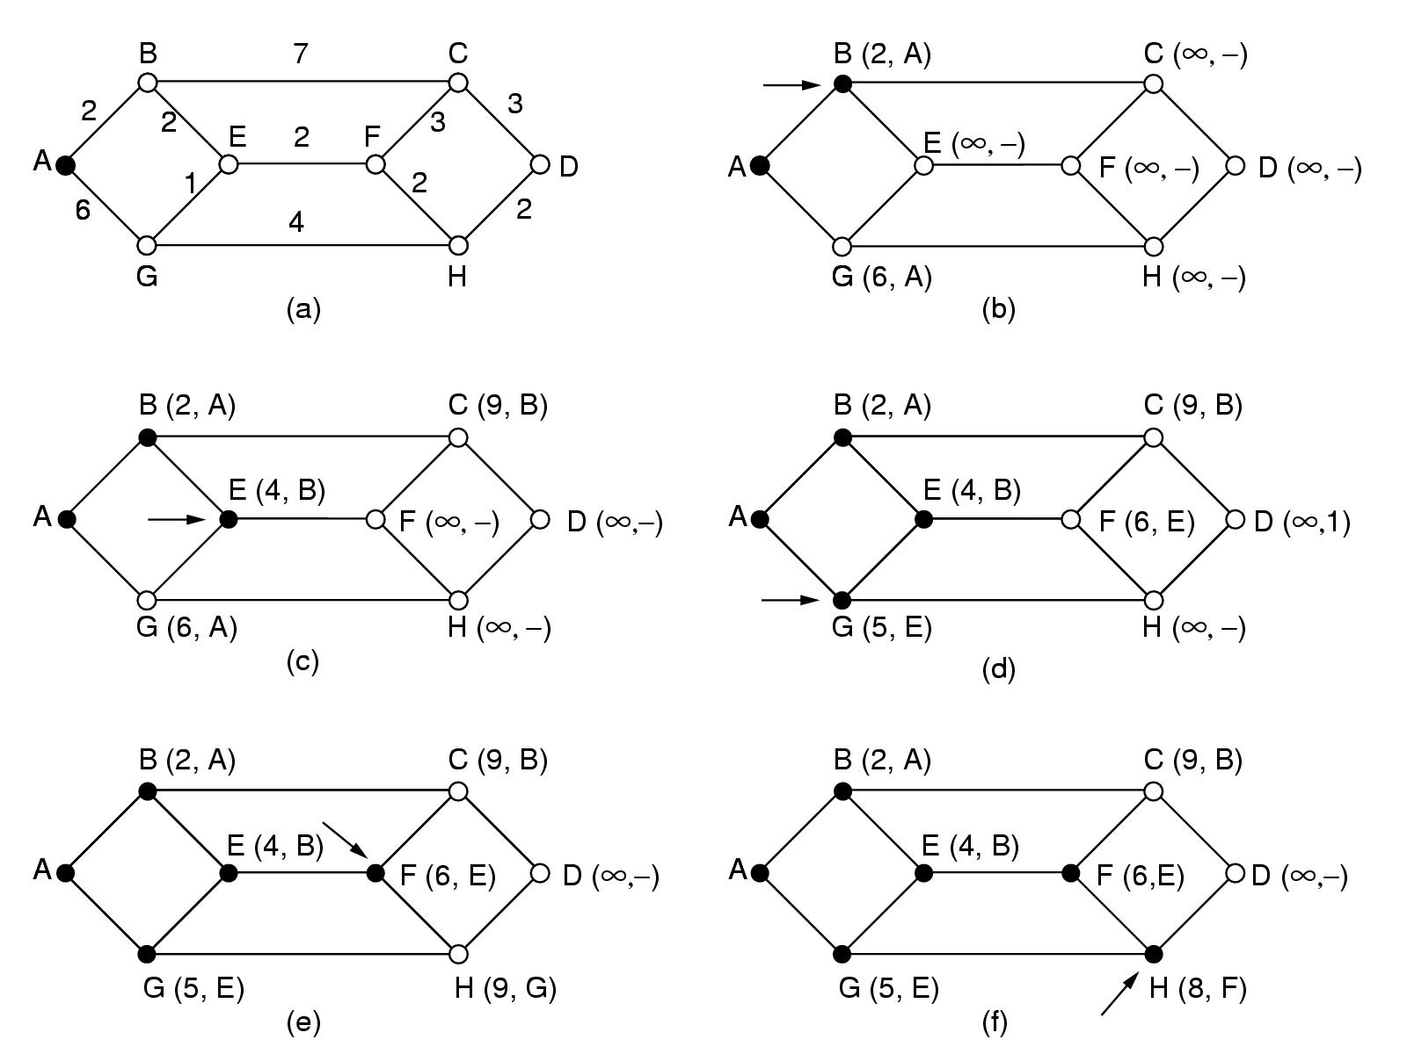
Routing: shortest path
Initial node
Elements of algorithm:
Mark all nodes as free: 
Mark initial node as selected: 
repeat till destination is selected:
Label all free nodes reachable from selected nodes with shortest distance to a selected node
Select free node with shortest distance to a selected node and mark it as selected

Slide 22
Routing: shortest path

Slide 23
Routing: distance vector (Bellman ford algorithm)
Adaptive algorithm
Exchange of info only with neighbours
Data to be available in each router
Routing table: per destination
Distance
Outgoing line
Distance to all neighbours
another name → Ford Fulkerson algorithm (1962)
It is developed for ARPANET. Now it is also used in Internet with a name RIP

Slide 24
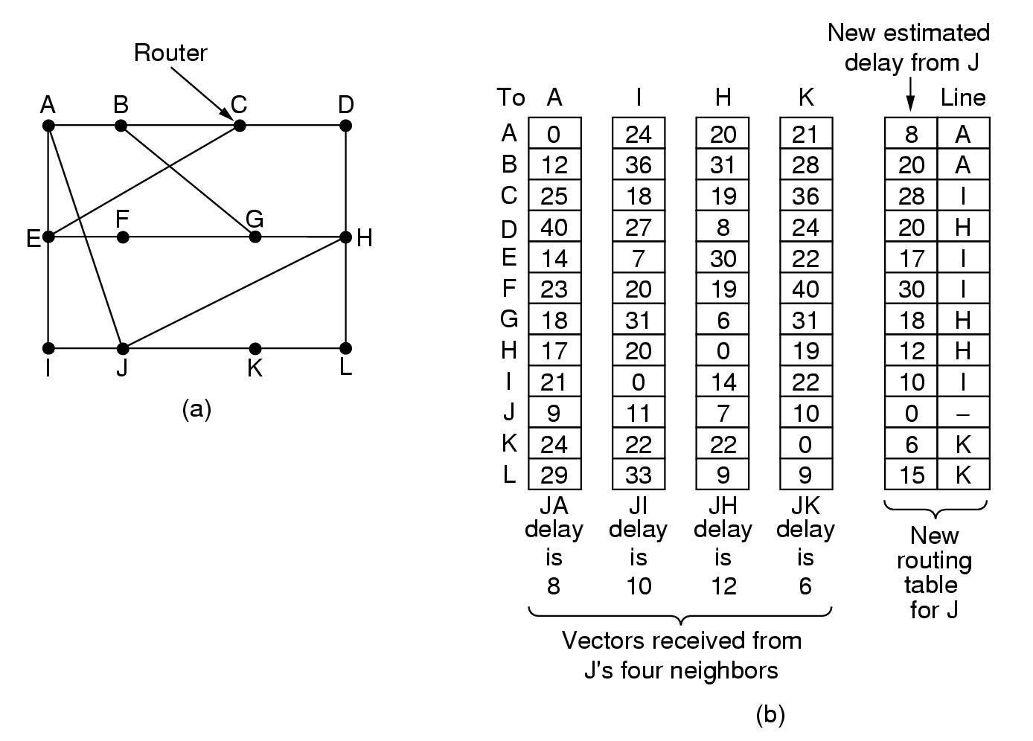
Routing: distance vector
Routing table for A
To | cost | via
A | 0 | -
B | 12 | B
C | 25 | B
D | 40 | B
E | 14 | E
F | 23 | E
G | 18 | B
H | 17 | J
I | 21 | E
J | 9 | J
K | 24 | J
L | 29 | J

Slide 25
Routing: distance vector
Algorithm
At each step within a router:
Get routing tables from neighbours
Compute distance to neighbours
Compute new routing table
Characteristics:
Iterative
Asynchronous
Distributed

Slide 26
Routing: distance vector
Routing tables from

Slide 27
Routing: distance vector
Better?
Keep 4 tables (one for each neighbour)
Use shortest path

Slide 28
Routing: distance vector
Distributed algorithm
Triggers:
Change in delay to neighbour
Receive new table from neighbour
Update local tables
If changed: forward routing tables to neighbours
Asynchronous
Execution in lock step not required
Iterative
Stops?
How fast are changes propagated?
Good news?
Bad news?

Slide 29
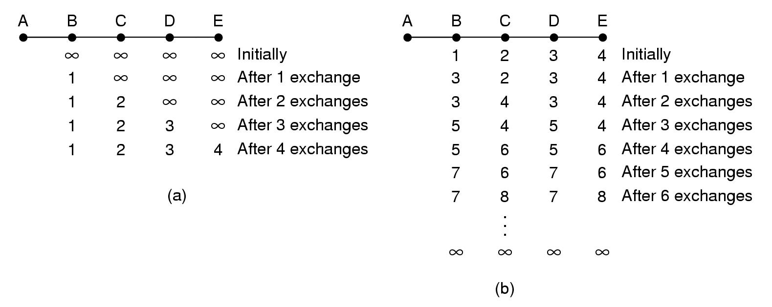
Routing: distance vector
Good news:
A comes up again
Only distances to A
Faster not possible!!!

Slide 30
Routing: distance vector
Bad news:
A goes down
B receives:
Distance ∞ from A
Distance 2 from C
New distance from B to A: 3 via C

Slide 31
Routing: distance vector
Bad news:
A goes down
C still
believes its distance to A is 2
routes via B
B routes its packets for A via C
LOOP!!!

Slide 32
Routing: distance vector
Bad news:
A goes down
Loops!!
Slow!!
∞ = 5?

Slide 33
Routing: distance vector
Split horizon hack:
Lie to neighbour about distance if routing via neighbour
A B C D E
1 2 3 4 initially
∞
∞
lie
∞ 2 3 4 1 iteration
Faster not possible!!
∞ ∞ 3 4 2 iterations
∞ ∞ ∞ 4 3 iterations

Slide 34
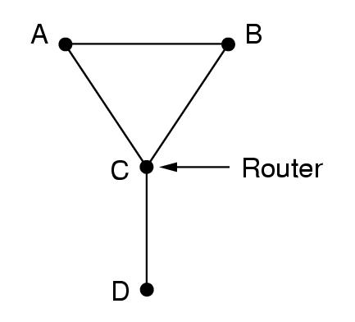
Routing: distance vector
Split horizon hack:
Hack ➔ does not always work
Example:
D goes down
A and B lie to C
A offers to B route to D
B offers to A route to D
Loops again!!!

Slide 35
Routing: link state routing
Distance Vector Routing protocols are used in ARPANET till 1979.
But it has 2 problems
1. if the delay metric is queue length, it did not take line bandwidth while choosing route.
2. count to infinity problem.
So it is replaced by entire new algorithm is called link state routing protocol.

Slide 36
Routing: link state
Overview of algorithm:
Each router must
Discover its neighbours and learn their network addresses
Measure the delay or cost to each of its neighbours
Construct a packet with these distances
Send this packet to all other routers
Compute the shortest path to every other router
The complete topology and all delays are experimentally measured and distributed to every router.
It uses Dijkstra’s algorithm to find shortest paths.

Slide 37
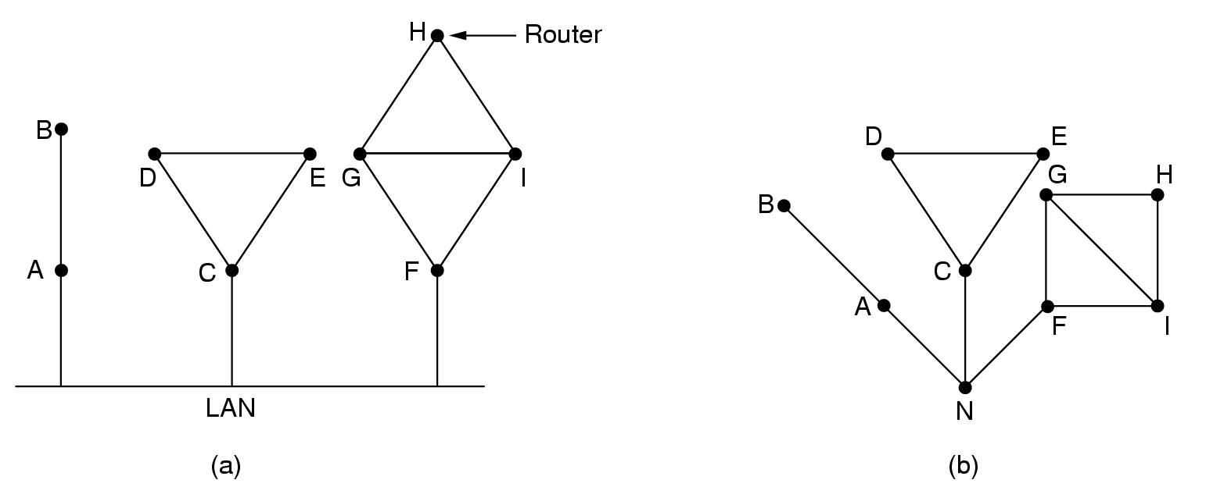
Routing: link state
Algorithm:
Learning about neighbours:
Upon boot of router
Send HELLO packet on each point-to-point line
Routers are supposed to send reply with a globally unique name
LAN model

Slide 38
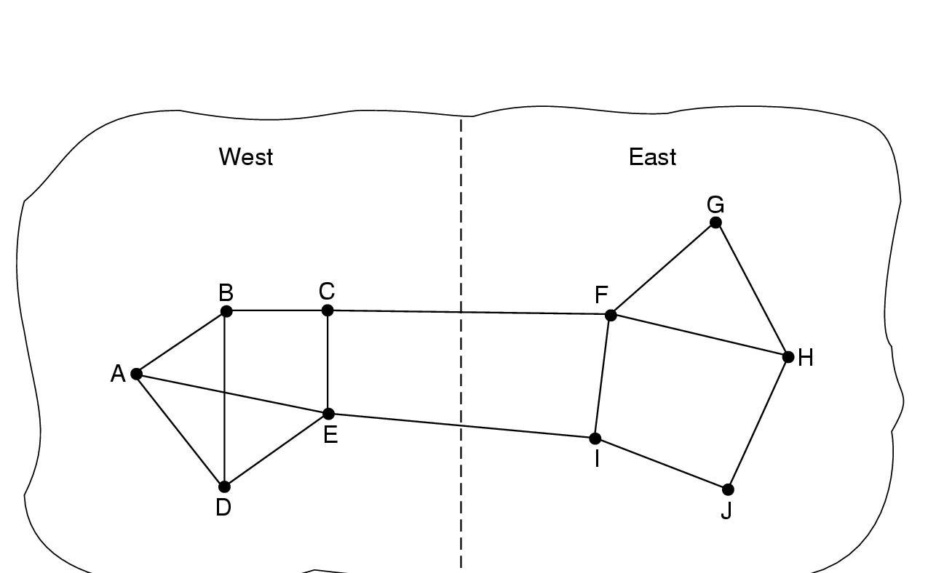
Routing: link state
Algorithm:
Measuring line cost
Measure round-trip delay of ECHO Packet and its reply
Take load into account? Arguments both ways:
Yes! preference for unloaded line
No! oscillations are possible

Slide 39
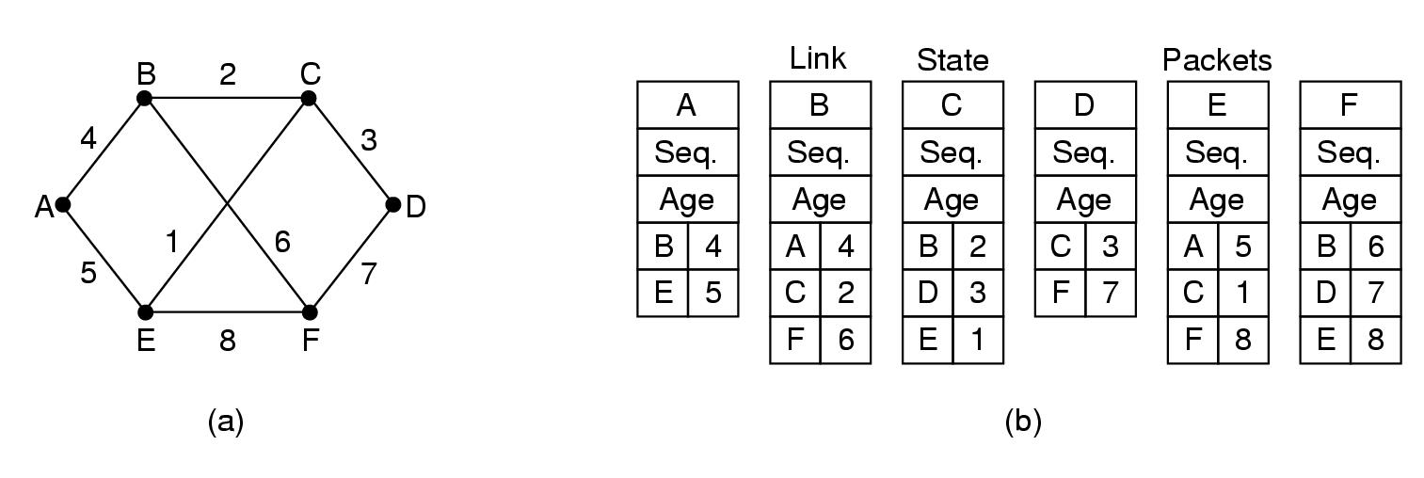
Routing: link state
Algorithm:
Building link state packets
Packet containing:
Identity of sender
Sequence number + age
For each neighbour: name + distance
When to build?
periodically
when significant events occur

Slide 40
Routing: link state
Algorithm:
Distributing link state packets
Trickiest part of algorithm
Arrival time for packets different
How to keep consistent routing tables
Basic algorithm
Flooding +
Sequence number (in each packet) to limit duplicates
Manageable problems
Wrap around of sequence numbers:
Wrong sequence number used:
lost in case of crash
Corruption
32 bits + 1 packet/sec ➔ 137 years
Age in each packet:
Decremented during flooding, while used in router
Age 0 ➔ info discarded

Slide 41
Routing: link state
Algorithm:
Distributing link state packets
Basic algorithm
Manageable problems
Refinements
Link state packets are not forwarded immediately
During holding time:
duplicates are discarded
Old packets are thrown out

Slide 42
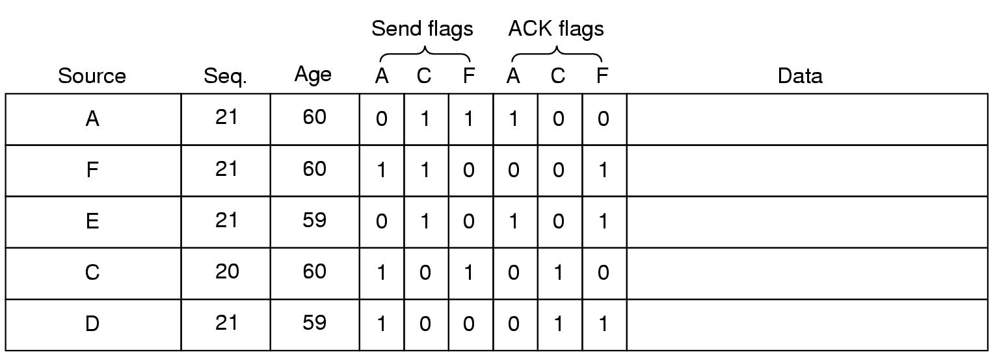
Network Layer
Packet buffer for router B
ACK flag: ACK to send
Send flag: packet to forward

Slide 43
Routing: link state
Algorithm:
Computing new routes:
With a full set of link state packets, a router can:
Construct the entire subnet graph
Run Dijkstra’s algorithm to compute the shortest path to each destination
Subnet of n router with k neighbours needed storage kn
Problems for large subnets
Memory to store data
Compute time
Big trouble if any router sends false information.

Slide 44
Routing: link state
Usage:
IS-IS protocol (another link state protocol)
Designed for DECnet, adopted by ISO
In use also in Internet
Supports multiple network layer protocols
OSPF protocol used in Internet
Common features:
Self-stabilizing method of flooding link state updates
Concept of a designated router on a LAN
Method of computing and supporting path splitting and multiple metrics

